Slide 1
UW WORKERS COMPENSATION CLAIMS: FIVE YEAR CLAIM HISTORY
1/1/05 – 12/31/09
University of Washington
Office of Risk Management
Claims Services Program
March 2010

Slide 2
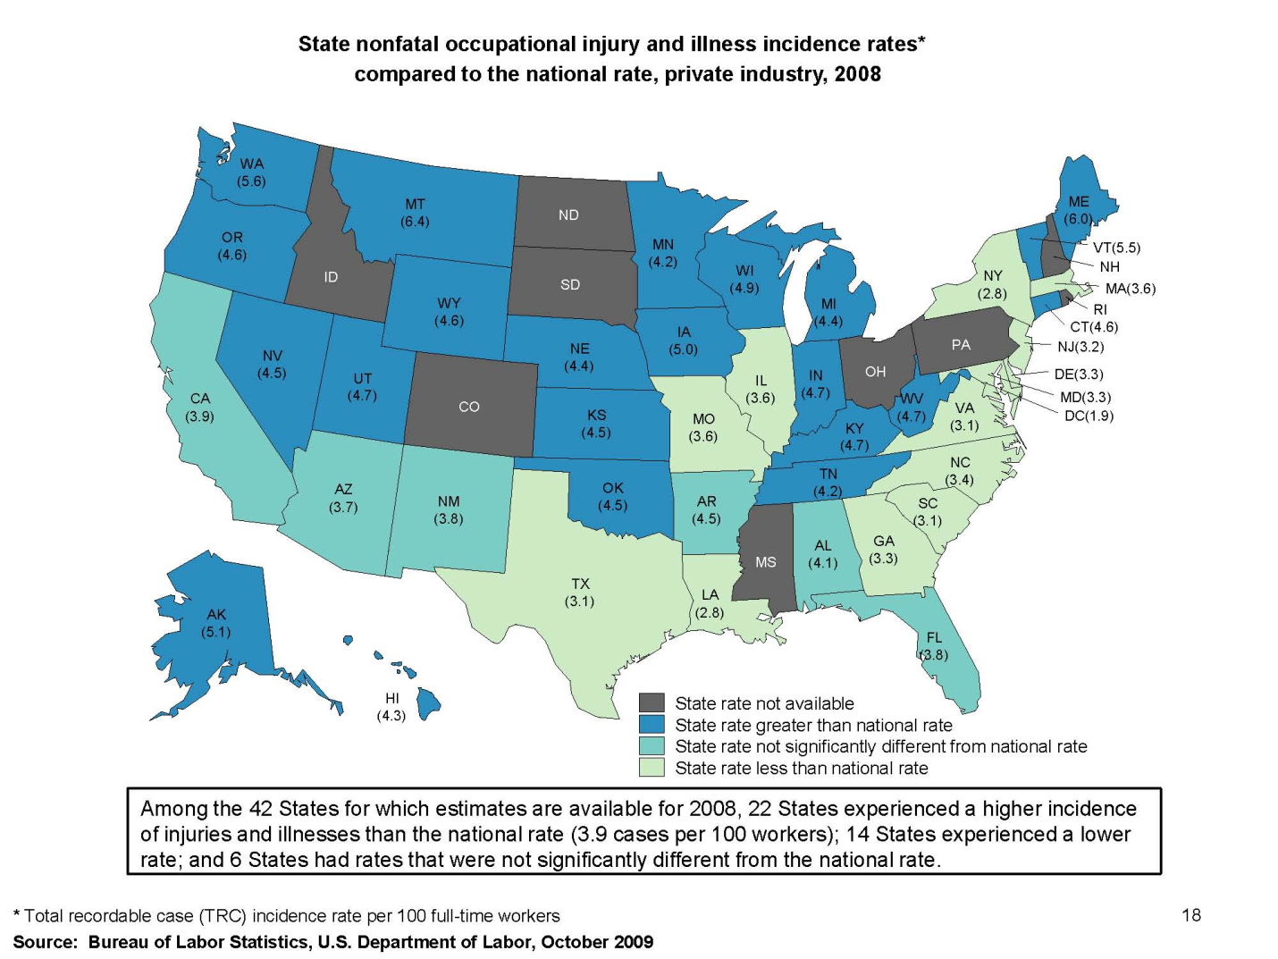
Workers Comp Claim Rates by State

Slide 3
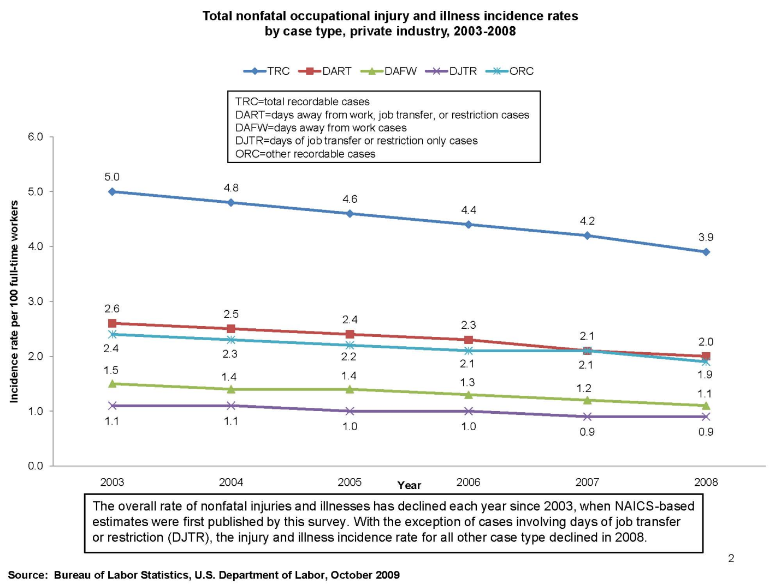
Nation-wide Occupational Injury/Disease Rates per 100 FTEs

Slide 4
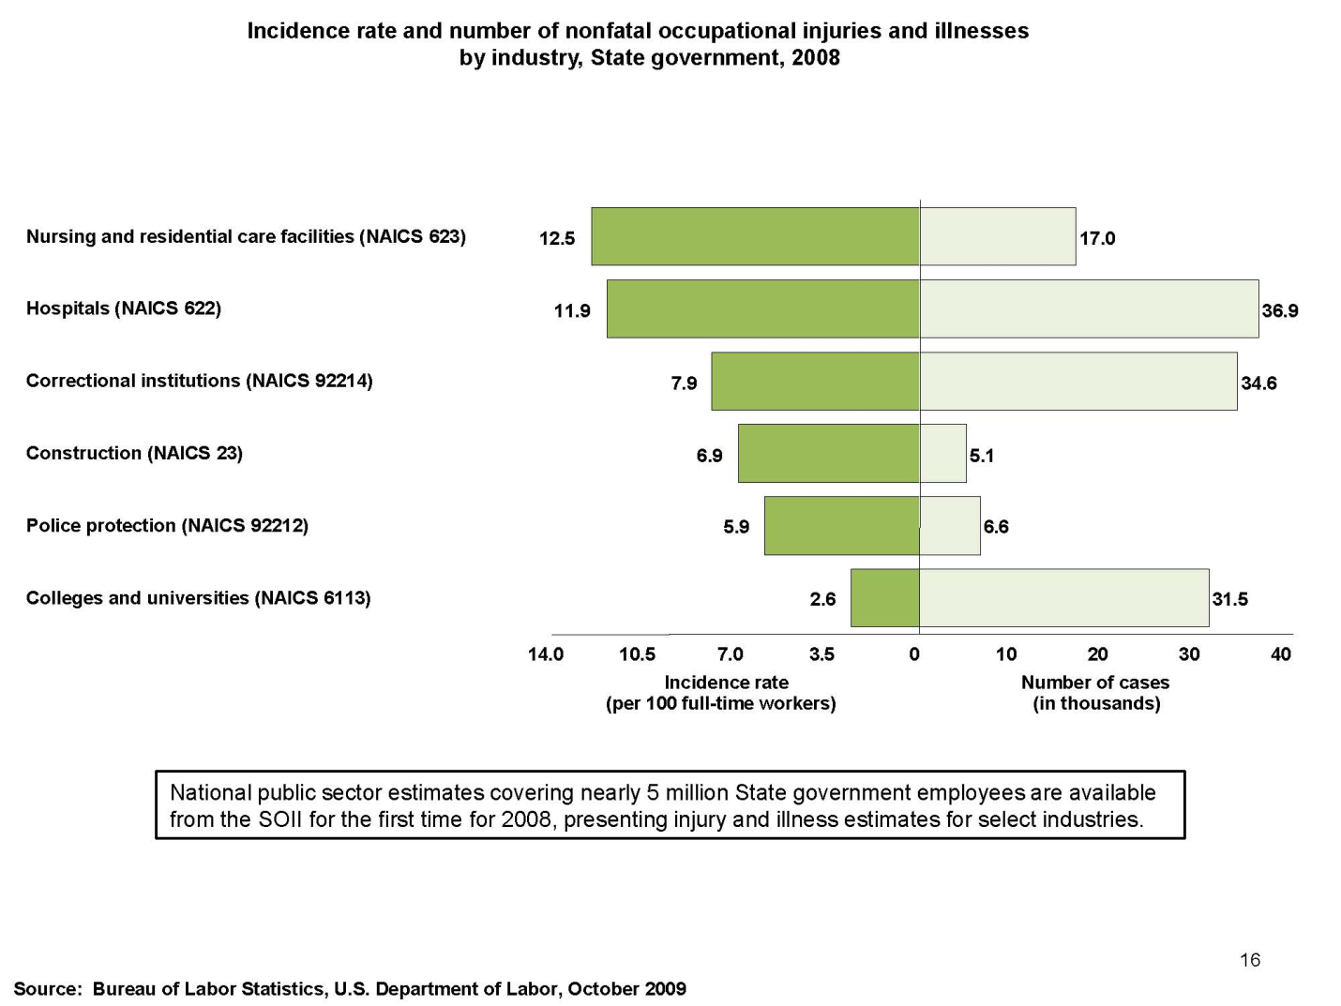
Nation-wide Incidents Rates for Sectors of State Government

Slide 5
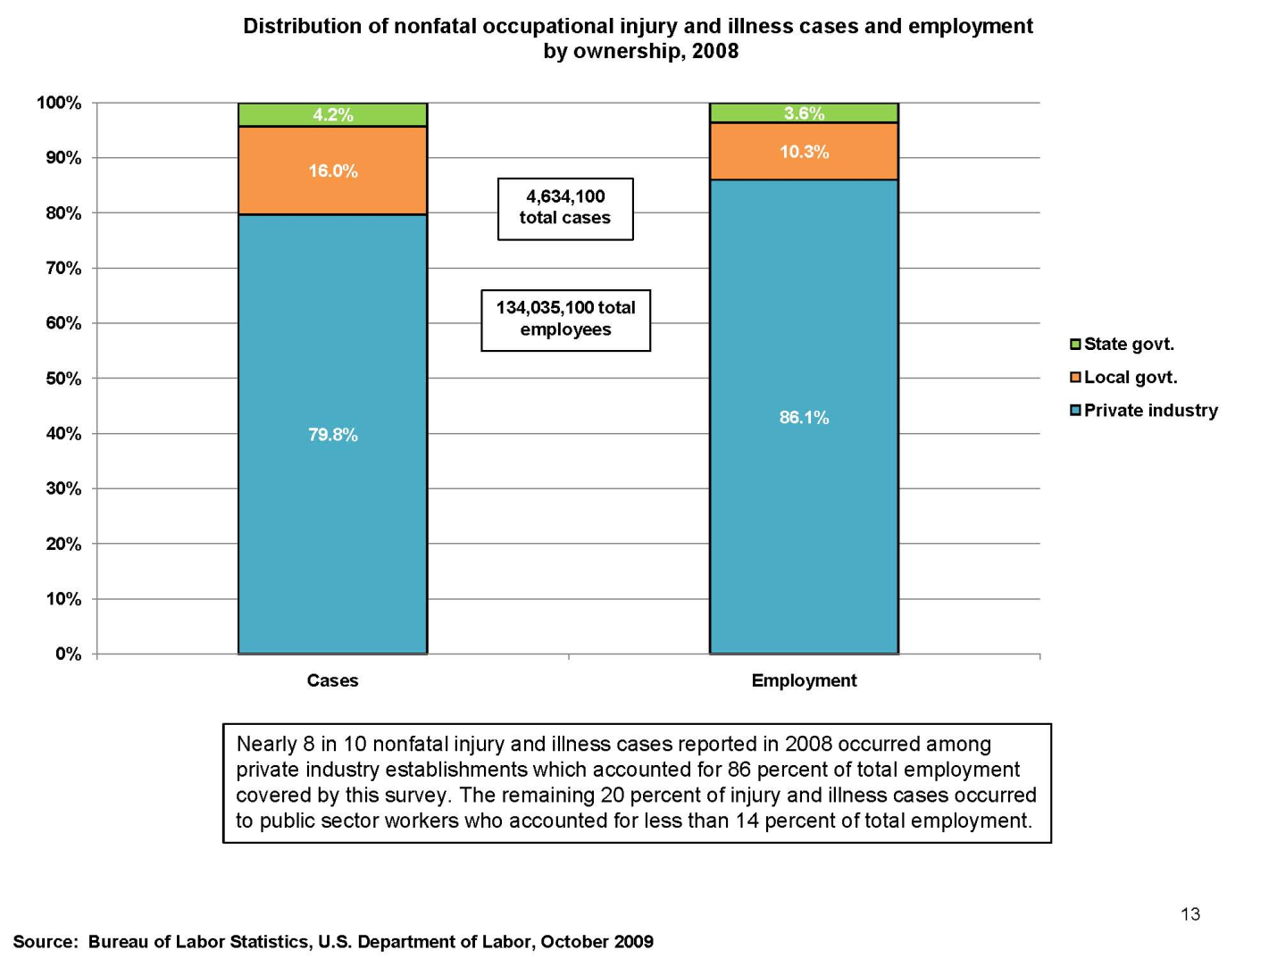
Nationwide State Government Claims as a % of Total

Slide 6
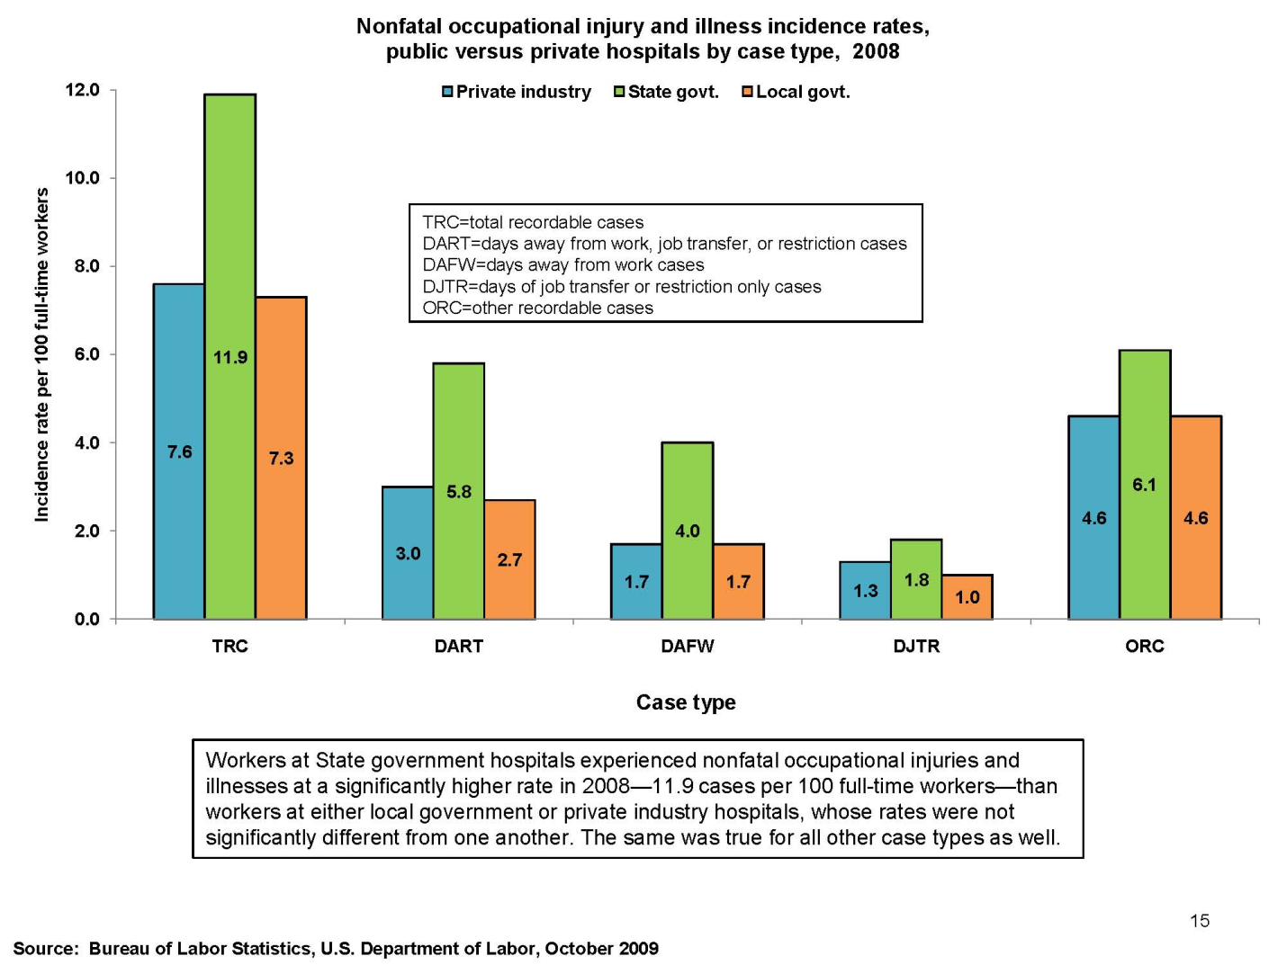
Nation-wide Claims: High Claim Rates at State Hospitals

Slide 7
Claim Rates – State Fund vs UW

Slide 8
L&I Insurance Information

Slide 9
UW Claim Frequency
(claims received in last 5 years, open and closed)
 | % Lost Time | % Med Only
2005 | 17% | 83%
2006 | 21% | 79%
2007 | 23% | 77%
2008 | 20% | 80%
2009 | 21% | 79%
5 year total | 20% | 80%

Slide 10
UW Claims Frequency by Division
(claims received in last 5 years, open and closed)
Division | Fatalities | Lost Time Claims | Medical-Only Claims | Total # of Claims | % of Total of UW
Harborview | 2 | 364 | 1085 | 1451 | 29%
UWMC |  | 227 | 915 | 1142 | 22%
Facilities |  | 219 | 490 | 709 | 14%
School of Medicine |  | 35 | 445 | 480 | 9%
Student Life |  | 66 | 208 | 274 | 5%
Health Sciences |  | 19 | 210 | 229 | 5%
Arts & Sciences | 1 | 8 | 152 | 161 | 3%
Oceanography |  | 5 | 58 | 63 | 1%
F&F/Bus Services |  | 12 | 46 | 58 | 1%
Engineering |  | 7 | 47 | 54 | 1%
All Other | 1 | 71 | 393 | 464 | 9%
TOTAL UW | 4 | 1033 | 4049 | 5085 | 100%

Slide 11
UW Claim Frequency by Top Divisions

Slide 12
UW-Wide Time Loss Days
(days out on open and closed claims each calendar year)

Slide 13
UW-Wide Time Loss Days by Division
(closed claims 1/1/04 – 12/31/09)
Division | # TL Days | % of total | % of EE's (per OSHA Reports)
Harborview | 19,740 | 36% | 14%
UWMC | 14,266 | 26% | 13%
Facilities | 12,096 | 22% | 3%
Student Life | 3,781 | 7% | 2%
Health Sciences | 1,100 | 2%
School of Medicine | 839 | 2%
F&F/Bus Services | 457 | 1%
Oceanography | 437 | 1%
Engineering | 435 | 1%
Public Health | 308 | 1%
All Other | 1,593 | 3%
Total UW | 55,052
Average Time Loss Days
Division | Avg # of TL days per TL claim
Harborview | 65
UWMC | 71
Facilities | 65
Student Life | 62
Health Sciences | 73
School of Medicine | 28
F&F/Business Services | 46
Oceanography | 87
Engineering | 62
Public Health | 308
All Other | 25

Slide 14
Time Loss Days by Dept - Top Divisions
HMC Department | # of TL days | % of Total
NURSING, GENERAL | 3,765 | 19%
ENVIRONMENTAL SVCS | 3,494 | 18%
SECURITY/FAC SVCS | 1,343 | 7%
BURN CENTER | 950 | 5%
SURGERY | 929 | 5%
PSYCHIATRY | 817 | 4%
INTERNAL MEDICINE | 794 | 4%
ADMIN. SUPPORT SVCS | 660 | 3%
NUTRITION AND FOOD | 635 | 3%
REHAB MEDICINE | 618 | 3%
OTHER | 5,735 | 29%
TOTAL | 19,740 | 100%
UWMC Department | # TL Days | % of Total
NURSING, GENERAL | 1,534 | 11%
SURGERY | 1,499 | 11%
MATERIALS MGMT | 1,262 | 9%
CRITICAL CARE | 1,184 | 8%
ADMIN. SUPPORT SRVCS | 1,115 | 8%
ENVIRONMENTAL SVCS | 980 | 7%
SECURITY/FAC SRVCS | 916 | 6%
ORTHOPAEDICS | 893 | 6%
NUTRITION AND FOOD | 882 | 6%
CONSOLIDATED LAUNDRY | 798 | 6%
OTHER | 3,569 | 25%
TOTAL | 14,266 | 100%
Facilities Department | # TL Days | % of Total
PHYS PLANT/MAINT ALT | 4,626 | 38%
PHYS PLANT/CAMPUS OPS | 2,332 | 19%
PHYS PLANT/CUSTODIAL | 2,898 | 24%
PROP TRANSPORT | 1,308 | 11%
PHYS PLANT/ENG SRVCS | 406 | 3%
PHYS PLANT/GROUNDS | 199 | 2%
PARKING SERVICES | 69 | 1%
FINAN/ADMIN SRVCS | 50 | 0%
PURCHASING/STORES | 89 | 1%
FINANCIAL MGMT/ADMN | 20 | 0%
Other | 99 | 1%
Total | 12,096 | 100%
Student Life Department | # TL Days | % of Total
RETAIL FOOD SRVCS | 3,048 | 81%
RESIDENCE HALLS | 699 | 18%
STDNT ACTIV/UNION FAC | 543 | 14%
FAMILY HOUSING | 90 | 2%
ACAD SRVCS & FACILIT | 85 | 2%
ADMINISTRATION | 85 | 2%
ADMISSIONS & RECORDS | 42 | 1%
RECREATIONAL SPORTS | 31 | 1%
CAREER SRVCS | 6 | 0%
Total | 3,781 | 100%

Slide 15
TL Days Five Year Trend for each Division
(days out on open and closed claims each calendar year)

Slide 16
UW- Wide Time Loss Dollars Paid by Year
(Time Loss paid on open and closed claims each calendar year)

Slide 17
Time Loss $ Paid by Division
(closed claims 1-1-04 – 12-31-09)
 | TL paid | % of Total | % of EEs (per OSHA reports)
Harborview | $1,922,141 | 41% | 14%
UWMC | $1,273,719 | 27% | 13%
Facilities | $968,585 | 20% | 3%
Student Life | $203,371 | 4% | 2%
School of Medicine | $74,072 | 2%
Health Sciences | $60,874 | 1%
Tacoma | $39,418 | 1%
F&F/Bus Services | $37,106 | 1%
Oceanography | $32,776 | 1%
UW Technology | $22,888 | 0%
All Other | $101,326 | 2%
Total | $4,736,276 | 100%
Average Time Loss $ Paid
Division | Ave Time Loss $/Claim
Harborview | $6,282
UWMC | $6,369
Facilities | $6,885
Student Life | $3,334
School of Medicine | $2,469
Health Sciences | $4,058
Tacoma | $9,854
F&F/Bus Services | $3,711
Oceanography | $6,555
UW Technology | $3,815
All Other | $1,747
Total | $5,352

Slide 18
Time Loss $ Paid by Dept - Top Divisions
HMC Department | Time Loss $ Paid | % of Total
NURSING, GENERAL | $414,271 | 22%
ENVIRONMENTAL SVCS | $210,197 | 11%
SURGERY | $112,550 | 6%
REHAB MEDICINE | $111,671 | 6%
INTERNAL MEDICINE | $108,253 | 6%
BURN CENTER | $107,146 | 6%
SECURITY/FAC SVCS | $104,714 | 5%
PSYCHIATRY | $89,576 | 5%
RADIOLOGY/NUCLEAR MED | $72,690 | 4%
CRITICAL CARE | $59,477 | 3%
OTHER | $533,304 | 28%
TOTAL | $1,923,848 | 100%
UWMC Department | Time Loss $ Paid | % of Total
CRITICAL CARE | 230,154 | 18%
NURSING, GENERAL | 177,746 | 14%
SURGERY | 115,888 | 9%
ADMIN. SUPPORT SRVCS | 108,039 | 8%
MATERIALS MGMT | 89,973 | 7%
ORTHOPAEDICS | 65,245 | 5%
ENVIRONMENTAL SVCS | 59,021 | 5%
OB/GYN | 47,696 | 4%
CONSOLIDATED LAUNDRY | 44,241 | 3%
SECURITY/FAC SRVCS | 38,457 | 3%
Other | 297,259 | 23%
Total | 1,273,719 | 100%
Facilities Department | Time Loss $ Paid | % of Total
PHYS PLANT/MAINT ALT | $430,354 | 44%
PHYS PLANT/CAMPUS OPS | $221,665 | 23%
PHYS PLANT/CUSTODIAL | $145,324 | 15%
PROP TRANSPORT | $91,959 | 9%
PHYS PLANT/ENG SRVCS | $31,552 | 3%
PHYS PLANT/GROUNDS | $16,632 | 2%
PARKING SERVICES | $10,574 | 1%
FINAN/ADMIN SRVCS | $7,633 | 1%
PURCHASING/STORES | $4,900 | 1%
FINANCIAL MGMT/ADMN | 1,493 | 0%
Other | $6,498 | 1%
Total | $968,585 | 100%
Student Life Department | Time Loss $ Paid | % of Total
RETAIL FOOD SRVCS | $114,528 | 56%
RESIDENCE HALLS | $40,273 | 20%
STDNT ACTIV/UNION FAC | $29,803 | 15%
RECREATIONAL SPORTS | $4,433 | 2%
ADMINISTRATION | $4,307 | 2%
FAMILY HOUSING | $4,121 | 2%
ACAD SRVCS & FACILIT | $3,186 | 2%
ADMISSIONS & RECORDS | $2,666 | 1%
CAREER SRVCS | $54 | 0%
Total | $203,371 | 100%

Slide 19
Time Loss $ Trend for Top Divisions
(Time Loss paid on open and closed claims each calendar year)

Slide 20
UW Claims by Injury Type
( closed claims 1/1/04 – 12/31/09, ranked by TL $ Paid)
Injury Type | # of MO claims | # of TL claims | Time Loss Days | Time Loss Paid | % of Total TL Paid
SPRAIN/STRAIN | 940 | 392 | 27,909 | $2,541,927 | 54%
SLIP AND FALL | 167 | 77 | 4,811 | $435,191 | 9%
PAIN | 431 | 127 | 4,466 | $341,686 | 7%
FRACTURE | 70 | 53 | 3,362 | $269,388 | 6%
REPETITIVE TRAUMA | 87 | 30 | 2,889 | $187,715 | 4%
BRUISE/CONTUSION | 320 | 39 | 2,598 | $172,275 | 4%
HERNIA | 5 | 10 | 1,402 | $107,879 | 2%
SWELLING INFLAMMATION | 86 | 32 | 1,506 | $100,731 | 2%
UNKNOWN | 47 | 6 | 778 | $93,430 | 2%
SOFT TISSUE INJURY | 36 | 8 | 738 | $85,716 | 2%
OTHER | 1705 | 107 | 3,693 | $352,467 | 8%
TOTAL | 3894 | 881 | 54,152 | $4,688,404 | 100%

Slide 21
Injury Types: Medical Centers
UWMC: Injury Type | # of MO claims | # of TL claims | TL Days | TL $ | % of total
SPRAIN/STRAIN | 206 | 81 | 6,934 | $737,707 | 58%
PAIN | 117 | 40 | 1,376 | $113,969 | 9%
RPTITV TRAUMA | 5 | 11 | 1,703 | $109,133 | 9%
BRUISE/CONTUSION | 56 | 7 | 997 | $71,068 | 6%
FRACTURE | 12 | 8 | 1,014 | $50,431 | 4%
SLIP AND FALL | 49 | 10 | 411 | $37,065 | 3%
SWELLING/INFLAMMATION | 12 | 7 | 573 | $32,269 | 3%
UNKNOWN | 9 | 2 | 93 | $29,029 | 2%
LACERATION | 43 | 7 | 396 | $28,478 | 2%
SOFT TISSUE INJ | 7 | 3 | 148 | $17,463 | 1%
Other | 366 | 24 | 621 | $47,105 | 4%
Total | 885 | 200 | 14,266 | $1,273,716 | 100%
UWMC
HMC: Injury Type | # of MO claims | # of TL claims | TL Days | TL $ | % of total
SPRAIN/STRAIN | 339 | 140 | 10,942 | $1,094,414 | 57%
SLIP AND FALL | 43 | 26 | 2,856 | $281,463 | 15%
PAIN | 131 | 47 | 2,226 | $171,286 | 9%
FRACTURE | 8 | 17 | 883 | $109,722 | 6%
BRUISE/CONTUSION | 138 | 11 | 701 | $51,889 | 3%
EXPOSURE | 23 | 9 | 408 | $25,569 | 1%
REPETITIVE TRAUMA | 23 | 5 | 336 | $20,317 | 1%
OTHER DISEASES | 20 | 1 | 244 | $14,177 | 1%
HERNIA | 3 | 6 | 208 | $24,315 | 1%
EPICHONDYLITIS | 2 | 4 | 194 | $51,497 | 3%
OTHER | 352 | 76 | 690 | $72,650 | 4%
TOTAL | 1082 | 302 | 19,688 | $1,917,298 | 100%
HMC

Slide 22
Injury Types: Facilities and Student Life
Facilities: Injury Type | # of MO claims | # of TL claims | TL Days | TL $ | % of total
SPRAIN/STRAIN | 134 | 13 | 6,723 | $533,463 | 55%
FRACTURE | 50 | 18 | 1,121 | $89,727 | 9%
HERNIA | 1 | 2 | 982 | $70,746 | 7%
UNKNOWN | 9 | 2 | 513 | $55,626 | 6%
SLIP AND FALL | 14 | 20 | 389 | $43,632 | 5%
BRUISE/CONTUSION | 33 | 15 | 732 | $33,959 | 4%
DISLOCATION | 0 | 2 | 399 | $33,154 | 3%
SOFT TISSUE INJURY | 3 | 2 | 299 | $28,947 | 3%
PAIN | 50 | 25 | 270 | $16,206 | 2%
AMPUTATION | 0 | 3 | 135 | $10,863 | 1%
OTHER | 179 | 25 | 533 | $52,262 | 5%
TOTAL | 473 | 127 | 12,096 | $968,585 | 100%
Facilities
Student Life: Injury Type | # of MO claims | # of TL claims | TL Days | TL $ | % of total
SPRAIN/STRAIN | 44 | 24 | 1,500 | $80,332 | 40%
BRUISE/CONTUSION | 16 | 4 | 914 | $47,626 | 23%
SLIP AND FALL | 14 | 7 | 458 | $25,798 | 13%
SWELLING/INFLAMMATION | 4 | 3 | 151 | $11,871 | 6%
UNKNOWN | 2 | 2 | 165 | $8,486 | 4%
PAIN | 16 | 6 | 157 | $6,977 | 3%
FRACTURE | 4 | 5 | 151 | $6,763 | 3%
LACERATION | 40 | 2 | 26 | $3,679 | 2%
SOFT TISSUE INJURY | 1 | 1 | 74 | $3,212 | 2%
REPETITIVE TRAUMA | 5 | 1 | 42 | $2,666 | 1%
OTHER | 59 | 5 | 143 | $5,962 | 3%
TOTAL | 205 | 60 | 3,781 | $203,371 | 100%
Student Life

Slide 23
Claims by Position
(closed claims 1/1/04 – 12/31/09, ranked by TL $ Paid)
Position Code/Description | # of MO claims | # of TL claims | TL Days | TL $ | % of total
Reg Nurses | 605 | 173 | 10,405 | $1,398,549 | 30%
Custodian | 322 | 144 | 8,994 | $473,411 | 10%
Med Asst | 105 | 44 | 2,677 | $219,727 | 5%
Hosp Asst | 135 | 38 | 2,487 | $172,910 | 4%
PL/Pipe/Steamfitter | 36 | 24 | 1,613 | $166,676 | 4%
Painter | 22 | 13 | 1,777 | $144,582 | 3%
Occup Therapist | 14 | 3 | 717 | $111,025 | 2%
Pat Fin Svcs Specialist | 79 | 17 | 1,065 | $98,677 | 2%
Mental Health Specialist | 18 | 5 | 869 | $98,024 | 2%
Food Services | 93 | 19 | 1,868 | $93,629 | 2%
Other | 2473 | 404 | 22,580 | $1,762,506 | 37%
TOTAL | 3902 | 884 | 55,052 | $4,739,716 | 100%

Slide 24
Claims By Position: Medical Centers
UWMC: POSITION | # of MO claims | # of TL claims | TL Days | TL $ | % of total
REG NURSE | 291 | 64 | 3,995 | $551,465 | 43%
HOSP ASST | 61 | 20 | 1,854 | $138,949 | 11%
PATIENT SVCS REP | 40 | 11 | 792 | $82,261 | 6%
CUSTODIAN | 67 | 19 | 1,265 | $73,968 | 6%
HOSP CENT SVC TECH | 17 | 9 | 742 | $55,385 | 4%
MEDICAL ASST | 34 | 9 | 365 | $47,774 | 4%
PROGRAM ASSISTANT | 7 | 1 | 555 | $43,985 | 3%
FDA - PROJECT | 4 | 1 | 616 | $37,037 | 3%
FOOD SERV WORKER | 20 | 6 | 782 | $35,941 | 3%
PHARMACY TECH | 8 | 3 | 416 | $29,129 | 2%
OTHER | 333 | 67 | 2,884 | $177,826 | 14%
TOTAL | 882 | 200 | 14,266 | $1,273,719 | 100%
UWMC
HMC: POSITION | # of MO claims | # of TL claims | TL Days | TL $ | % of total
REG NURSE | 310 | 110 | 6,396 | $846,988 | 44%
CUSTODIAN | 106 | 40 | 3,373 | $197,538 | 10%
MEDICAL ASSISTANT | 21 | 35 | 2,312 | $171,953 | 9%
MENTAL HEALTH SPEC | 17 | 5 | 869 | $98,024 | 5%
OCCUP THERAPIST | 6 | 2 | 489 | $88,345 | 5%
IMAGING TECH | 26 | 12 | 579 | $64,098 | 3%
RESP CARE | 13 | 10 | 337 | $45,117 | 2%
FACIL OPS MAINT SPEC | 7 | 4 | 331 | $44,064 | 2%
SECURITY OFCR | 77 | 6 | 555 | $37,083 | 2%
HOSPITAL ASST | 62 | 19 | 633 | $33,961 | 2%
OTHER | 401 | 131 | 3,811 | $289,072 | 15%
TOTAL | 1046 | 374 | 19,685 | $1,916,244 | 100%
HMC

Slide 25
Claims By Position: Facilities and Student Life
FACILITIES: POSITION | # of MO claims | # of TL claims | TL Days | TL $ | % of total
PL/PIPE/ STEAMFTTR | 32 | 24 | 1,613 | $166,676 | 17%
CUSTODIAN | 107 | 58 | 2,954 | $131,157 | 14%
PAINTER | 16 | 8 | 1,401 | $106,900 | 11%
ELEVATOR MECHANIC | 2 | 2 | 697 | $92,539 | 10%
TRUCK DRIVER 2 | 18 | 6 | 1,109 | $82,753 | 9%
MAINT MECHANIC | 25 | 10 | 685 | $62,139 | 6%
ELECTRICIAN | 47 | 9 | 691 | $55,627 | 6%
ROOFER | 1 | 5 | 457 | $36,768 | 4%
SHEET MTL MECH | 24 | 6 | 386 | $36,179 | 4%
INSULATION WORKER | 1 | 2 | 263 | $33,760 | 3%
OTHER | 197 | 54 | 1,840 | $164,087 | 17%
TOTAL | 470 | 184 | 12,096 | $968,585 | 100%
Facilities
STUDENT LIFE: POSITION | # of MO claims | # of TL claims | TL Days | TL $ | % of total
FOOD SERVICES | 131 | 21 | 1,913 | $101,776 | 50%
CUSTODIAN | 34 | 25 | 1,379 | $68,371 | 34%
MAINTENANCE | 4 | 3 | 136 | $14,081 | 7%
MGR PROGRAM OPS | 9 | 3 | 22 | $5,822 | 3%
ADMINISTRATIVE | 3 | 1 | 42 | $2,666 | 1%
OTHER | 24 | 0 | 0 | $10,656 | 0%
TOTAL | 205 | 61 | 3,781 | $203,371 | 100%
Student Life

Slide 26
Claims by Diagnosis
(closed claims 1/1/04 – 12/31/09, ranked by TL $ Paid)
Diagnosis | # of MO claims | # of TL claims | TL Days | TL $ | % of total
STRAIN, BACK | 314 | 164 | 7,644 | $777,884 | 16%
STRAIN, SHOULDER | 121 | 46 | 5,029 | $421,689 | 9%
PAIN, LWR. BACK | 93 | 61 | 4,704 | $439,648 | 9%
STRAIN, HAND/WRIST | 146 | 38 | 5,026 | $377,160 | 8%
STRAIN/SPRAIN, LEG/KNEE | 97 | 53 | 2,662 | $278,266 | 6%
CONTUSION/BRUISE | 403 | 60 | 3,270 | $242,395 | 5%
CARPAL TUNNEL | 62 | 36 | 3,862 | $239,110 | 5%
SPRAIN, CERVICAL | 121 | 34 | 1,341 | $148,609 | 3%
SPRAIN, ANKLE/FOOT | 113 | 26 | 1,175 | $136,440 | 3%
SPRAIN, MULTIPLE | 29 | 13 | 1,384 | $128,516 | 3%
Other | 2404 | 353 | 18,955 | $1,549,999 | 33%
TOTAL | 3903 | 884 | 55,052 | $4,739,716 | 100%

Slide 27
Top Diagnoses: Medical Centers
UWMC: Diagnosis | # of MO claims | # of TL claims | TL Days | TL $ | % of total
STRAIN, BACK | 44 | 24 | 2,955 | $365,657 | 29%
STRAIN, SHOULDER | 30 | 34 | 1,523 | $140,022 | 11%
CARPAL TUNNEL | 16 | 12 | 2,219 | $123,844 | 10%
LUMBAGO | 61 | 10 | 595 | $87,207 | 17%
CONTUSION/BRUISE | 84 | 9 | 1,082 | $82,083 | 6%
UNKNOWN | 17 | 5 | 317 | $43,496 | 3%
TENDONITIS, BURSITIS | 17 | 6 | 486 | $43,309 | 3%
SPRAIN, HAND/WRIST | 27 | 9 | 758 | $39,497 | 3%
FRACTURE, ARM/WRIST | 8 | 5 | 600 | $35,329 | 3%
SPRAIN, ANKLE /FOOT | 19 | 2 | 231 | $22,692 | 2%
OTHER | 559 | 84 | 3,443 | $284,796 | 22%
TOTAL | 882 | 200 | 14,209 | $1,267,830 | 100%
UWMC
HMC: Diagnosis | # of MO claims | # of TL claims | TL Days | TL $ | % of total
LUMBAR STRAIN | 119 | 54 | 2,492 | $276,687 | 14%
HAND/WRIST STRAIN | 54 | 17 | 2,455 | $198,791 | 10%
LUMBAGO | 29 | 25 | 1,936 | $172,870 | 9%
KNEE SPRAIN | 31 | 20 | 1,603 | $168,203 | 9%
SHOULDER SPRAIN | 36 | 15 | 1,388 | $130,626 | 7%
NECK SPRAIN | 34 | 10 | 792 | $107,852 | 6%
ANKLE/FOOT/TOE SPRAIN | 3 | 10 | 727 | $99,221 | 5%
FX ARM/WRIST | 1 | 8 | 560 | $78,668 | 4%
EPICHONDYLITIS | 5 | 6 | 279 | $57,319 | 3%
CONTUSION/BRUISE | 153 | 12 | 728 | $53,368 | 3%
OTHER | 581 | 131 | 8,990 | $580,243 | 30%
TOTAL | 1046 | 308 | 19,740 | $1,923,848 | 100%
HMC

Slide 28
Top Diagnoses: Facilities and Student Life
Facilities: Diagnosis | # of MO claims | # of TL claims | TL Days | TL $ | % of total
LUMBAGO | 14 | 14 | 1,887 | $164,950 | 17%
STRAIN, SHOULDER | 22 | 7 | 1,625 | $118,789 | 12%
SPRAIN, WRIST /HAND | 22 | 6 | 1,448 | $117,330 | 12%
SPRAIN, LUMBAR | 34 | 35 | 1,226 | $80,599 | 8%
CONTUSION/BRUISE | 41 | 19 | 1,066 | $74,812 | 8%
STRAIN, MULTIPLE | 2 | 4 | 787 | $62,546 | 6%
SPRAIN, KNEE | 11 | 10 | 315 | $46,397 | 5%
FRACTURE, LEG | 0 | 1 | 364 | $42,085 | 4%
DISLOCATION, SHOULDER | 0 | 1 | 358 | $28,897 | 3%
SLIP FALL | 0 | 2 | 272 | $22,749 | 2%
OTHER | 327 | 99 | 2,720 | $206,516 | 21%
TOTAL | 473 | 185 | 12,068 | $965,669 | 100%
Facilities
Student Life: Diagnosis | # of MO claims | # of TL claims | TL Days | TL $ | % of total
TENDONITIS, BURSITIS | 5 | 4 | 879 | $51,434 | 25%
STRAIN, ARM | 0 | 2 | 323 | $24,001 | 12%
SPRAIN, LUMBAR | 17 | 5 | 404 | $19,010 | 9%
FRACTURE, HIP | 0 | 1 | 291 | $17,334 | 9%
STRAIN, SHOULDER | 6 | 2 | 388 | $15,806 | 8%
PAIN, LWR. BACK | 5 | 2 | 217 | $10,055 | 5%
FX FINGER/HAND/WRIST | 2 | 5 | 152 | $6,378 | 3%
CONTUSION/BRUISE | 20 | 6 | 114 | $5,308 | 3%
LACERATION | 41 | 2 | 26 | $3,679 | 2%
SPRAIN, HAND/WRIST | 10 | 3 | 60 | $3,102 | 2%
OTHER | 99 | 29 | 927 | $47,263 | 23%
TOTAL | 205 | 61 | 3,781 | $203,371 | 100%
Student Life

Slide 29
Claims by Body Part
(closed claims 1/1/04 – 12/31/09, ranked by TL $ Paid)
Body Part | # of MO claims | # of TL claims | TL Days | TL $ | % of total
BACK | 540 | 279 | 13,961 | 1,413,700 | 30%
SHOULDER | 194 | 74 | 7,666 | 649,511 | 14%
WRIST | 225 | 52 | 6,912 | 483,132 | 10%
KNEE | 187 | 96 | 4,928 | 458,557 | 10%
HAND | 229 | 48 | 2,837 | 210,403 | 4%
NECK | 110 | 21 | 2,043 | 191,173 | 4%
ELBOW | 99 | 25 | 1,786 | 173,903 | 4%
FOOT | 96 | 24 | 1,432 | 168,592 | 4%
MULTIPLE | 75 | 24 | 2,398 | 155,910 | 3%
FINGER | 528 | 42 | 1,600 | 113,922 | 2%
Other | 1619 | 199 | 9,489 | 720,913 | 15%
Total | 3902 | 884 | 55,052 | 4,739,716 | 100%

Slide 30
Claims by Body Part: Medical Centers
UWMC: Body Part | # of MO claims | # of TL claims | TL Days | TL $ | % of total
BACK | 138 | 61 | 3,798 | $499,432 | 39%
SHOULDER | 41 | 22 | 2,448 | $243,569 | 19%
WRIST | 43 | 11 | 2,524 | $133,754 | 11%
HAND | 61 | 16 | 1,160 | $93,953 | 7%
ELBOW | 21 | 6 | 908 | $73,917 | 6%
FOOT | 15 | 7 | 378 | $38,128 | 3%
KNEE | 34 | 10 | 600 | $37,844 | 3%
NECK | 16 | 6 | 353 | $37,458 | 3%
THUMB(S) | 49 | 6 | 536 | $34,239 | 3%
FINGER | 98 | 13 | 577 | $17,238 | 1%
Other | 366 | 41 | 889 | $58,402 | 5%
Total | 882 | 199 | 14,171 | $1,265,992 | 100%
UWMC
HMC: Body Part | # of MO claims | # of TL claims | TL Days | TL $ | % of total
BACK | 194 | 106 | 5,166 | $527,840 | 28%
KNEE | 62 | 41 | 2,967 | $287,803 | 15%
WRIST | 59 | 16 | 1,823 | $184,504 | 10%
NECK | 38 | 12 | 1,568 | $147,612 | 8%
SHOULDER | 59 | 18 | 1,371 | $142,691 | 7%
FOOT | 31 | 5 | 782 | $113,107 | 6%
MULTIPLE | 20 | 8 | 1,276 | $73,003 | 4%
ELBOW | 26 | 7 | 377 | $59,742 | 3%
FINGER | 89 | 14 | 692 | $55,149 | 3%
FOREARM | 21 | 4 | 296 | $54,675 | 3%
OTHER | 447 | 77 | 3,422 | $271,172 | 14%
Total | 1046 | 308 | 19,740 | $1,917,298 | 100%
HMC

Slide 31
Claims by Body Part:
Facilities and Student Life
Facilities: Body Part | # of MO claims | # of TL claims | TL Days | TL $ | % of total
BACK | 67 | 61 | 3,650 | $314,340 | 32%
SHOULDER | 34 | 20 | 2,570 | $192,489 | 20%
WRIST | 22 | 11 | 1,916 | $148,395 | 15%
KNEE | 24 | 21 | 700 | $86,038 | 9%
MULTIPLE | 11 | 6 | 813 | $66,105 | 7%
LOWER LEG | 4 | 2 | 364 | $42,085 | 4%
FINGER | 51 | 6 | 218 | $23,193 | 2%
HAND | 29 | 4 | 292 | $16,847 | 2%
ELBOW | 15 | 7 | 158 | $15,158 | 2%
FOOT | 11 | 6 | 174 | $12,631 | 1%
Other | 205 | 40 | 1,237 | $51,304 | 5%
Total | 473 | 184 | 12,092 | $968,364 | 100%
Facilities
Student Life: Body Part | # of MO claims | # of TL claims | TL Days | TL $ | % of total
WRIST | 14 | 7 | 1,086 | $55,015 | 27%
BACK | 26 | 18 | 646 | $30,378 | 15%
UPPER ARM | 1 | 1 | 323 | $24,001 | 12%
SHOULDER | 10 | 3 | 430 | $18,472 | 9%
HIP | 1 | 1 | 291 | $17,334 | 9%
KNEE | 15 | 5 | 154 | $16,925 | 8%
MULTIPLE | 3 | 3 | 168 | $9,298 | 5%
HAND | 21 | 5 | 151 | $6,560 | 3%
FINGER | 30 | 4 | 89 | $5,718 | 3%
LOWER ARM | 0 | 1 | 124 | $5,331 | 3%
OTHER | 84 | 13 | 319 | $14,339 | 7%
TOTAL | 205 | 61 | 3,781 | $203,371 | 100%
Student Life

Slide 32
Safety is Job #1!
Avoiding worker injuries protects our employees, reduces insurance costs, and increases UW productivity.
Partnership with EH&S on data and safety issues
  Sharing of Workers Comp data real-time
    To ensure incident reports are complete
    To ensure OSHA reporting is accurate
    To share trends on safety issues
  Triage discussions on unusual or severe incidents so UW responds appropriately and as a team
  Initiatives to address trends – i.e., ergonomics, lifting, etc

Slide 33
Key to Controlling Costs: Return-to-Work
Benefits to UW
  Lower L&I premium
  Allows retention of employee’s skill and experience
  Keeps productivity loss to a minimum
  Reduces costs of training new employee or temps
  Creates opportunity to complete work usually left undone
  May reduce risk of re-injury
Benefits to the Injured Worker:
  Keeps the employee active and speeds medical recovery
  Shifts focus from “dis-ability” to ability
  May reduce the risk of re-injury
  Provides a sense of job security
  Allows employee to maintain contact with co-workers
  Shows you value your employee and his/her contributions to UW

Slide 34
UW’s Return to Work Program
Risk Management serves as UW’s required return-to-work coordinators (RCW 41.06.490)
Requires strong teamwork with L&I, HR, Supervisor/Department, Physician
Focus is on early, supportive communication with injured worker on opportunities to stay at work within restrictions
Return to Work Options
  Modify current work
  Part time work
  Alternative work (temporary)
  Alternative work (permanent)
Light duty job descriptions should be developed and readily available for positions with claim frequency
“We don’t have light duty” is rarely acceptable

Slide 35
Contact Us
Shari Spung, Director, Claims Services Program
(sspung@uw.edu, 206 616 3455)
Wendy Winslow-Nason, Sr. Claims Specialist
(wendywn@uw.edu, 206 616 7510)
Elena Williams, Claims Specialist
(elenaw2@uw.edu, 206 616 3329)
Linda Chihara, Program Coordinator
(lchihara@uw.edu, 206 543 0183)
Felicia Carnes, Program Coordinator
(fml@uw.edu, 206 543 3657)

